Slide 1
String , Date & Time Functions

Slide 2
Built in user defined Functions
Built-in String Functions and Date functions : These are common human activities required while programming, which are created as reusable methods and provided by the VB-developers as open libraries in windows environment.
Tester’s life’s made easier :Use these methods directly when ever required.

Slide 3
String Manipulation Functions
String Manipulation Functions
Asc
Mid
Chr
Len
Instr
Trim
Lcase
StrComp
Ucase
Replace
Left
Space
Right
Notes:
The various types of String Manipulation Functions available in VB Script are shown on screen:
Now, let us learn about each in detail.

Slide 4
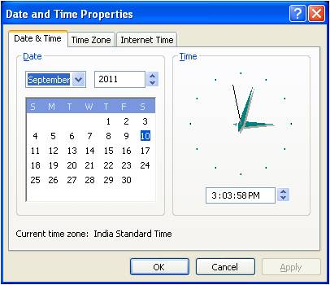
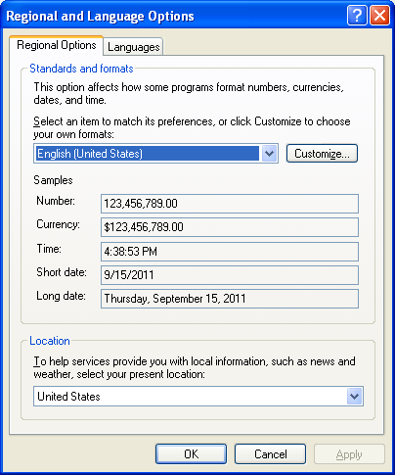
Date and Time Functions
Date and Time
Friday , September09,2011
Date
WeekDay
Now
WeekDayName
DateAdd
Year
Regional and Language options
DateDiff
Time
Day
Hour
Month
Minute
MonthName
Second
Notes:
The Date and Time functions allow you to extract date and time information as per the system date and time settings. The extracted date and time, using these functions would be in the format set in system’s Regional and Language options. Using these functions, you can also change the format of the date as per your needs.
The various types of Date and Time Functions provided by VB Script, are listed on screen:
Let us now learn each of the Data and Time Functions.

